Slide 1
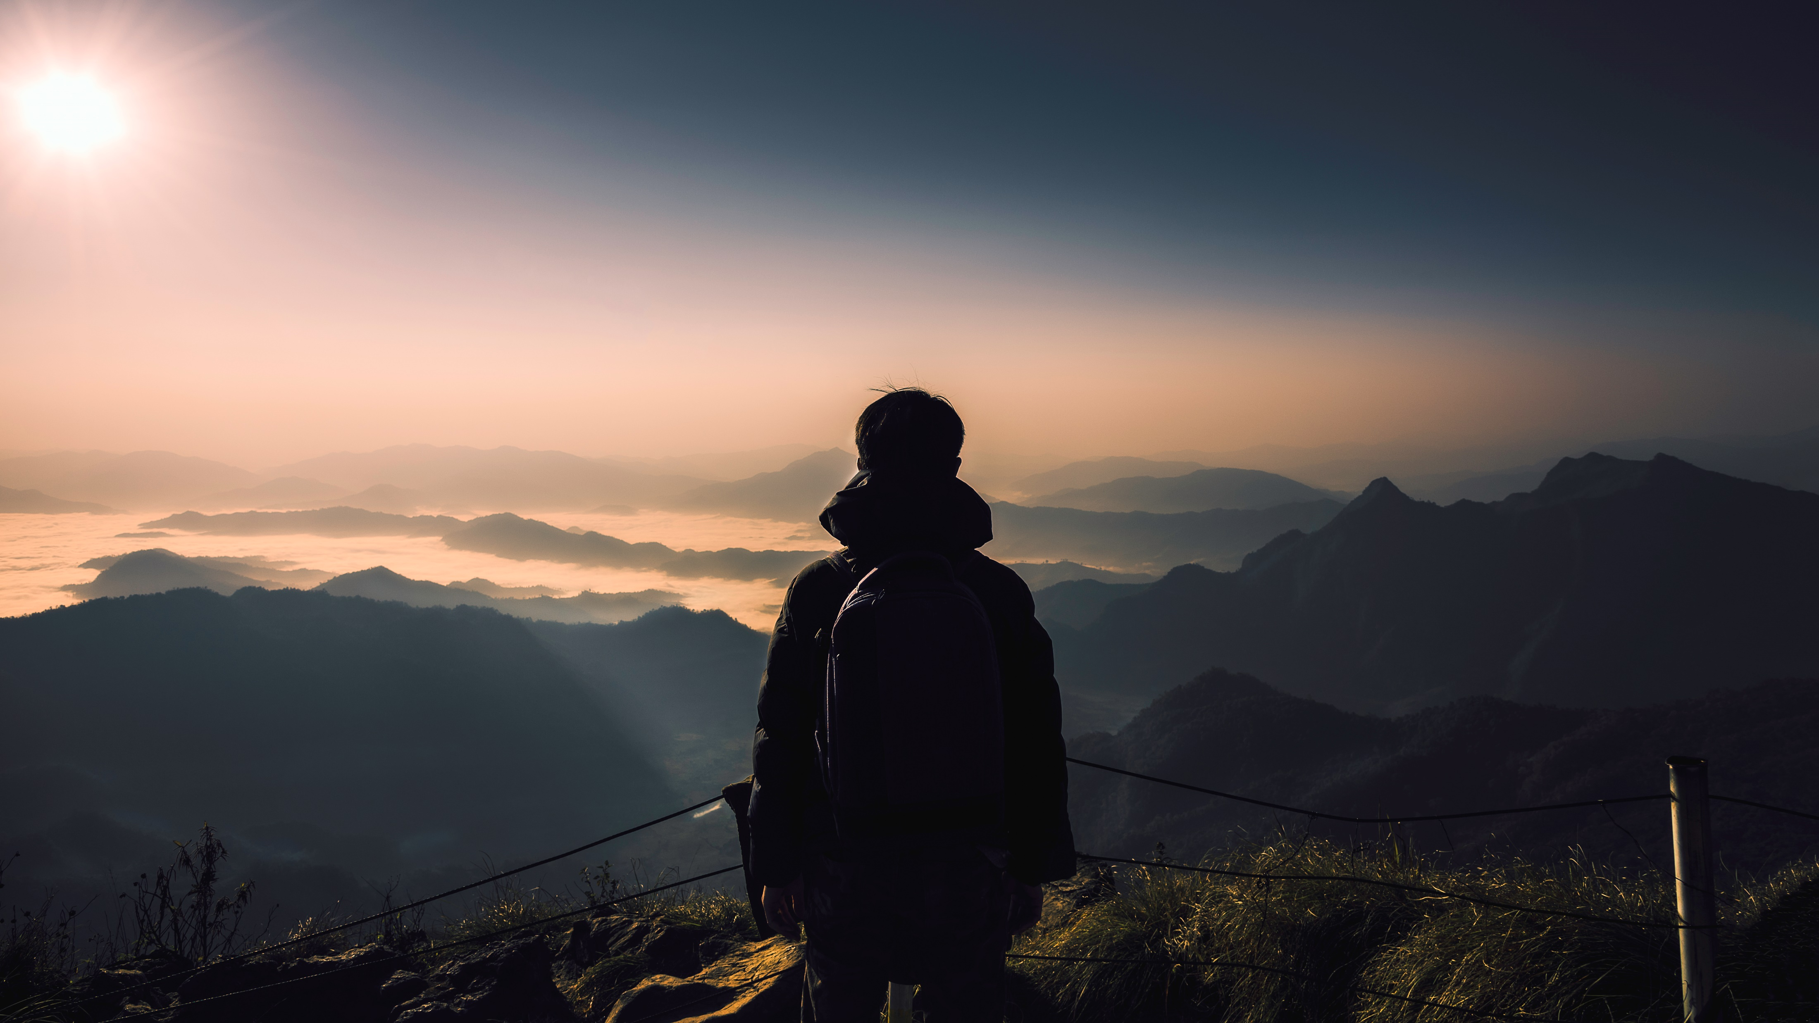
Anthony Bourdain’s Travels
Data Deviants
Project 3, Group 2
Van Eisele
Carlos De La Rosa
Abagail Chambers

Slide 2
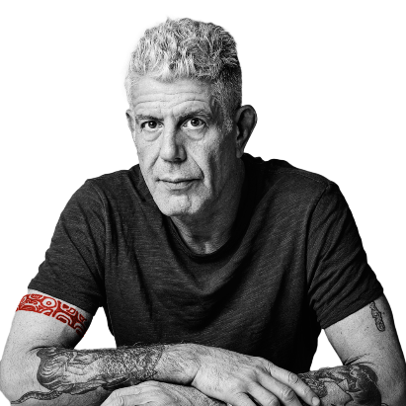
Introduction
Inspiration
We all love food, and we all love Anthony Bourdain, so it was not a difficult decision to delve into his travels for app.
Dataset
https://www.kaggle.com/datasets/michaelbryantds/anthony-bourdain-episode-locations?resource=download

Slide 3
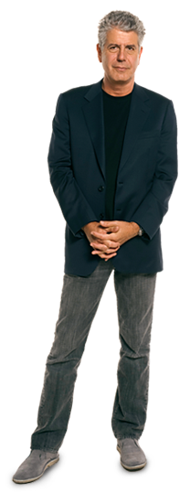
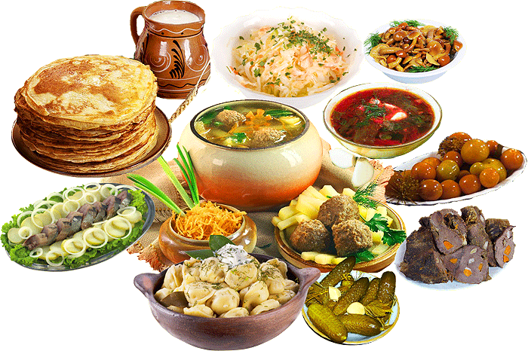

Design Inspiration
Color Scheme
We went with a mostly earthy palette, with pops of red and blue for emphasis.
Some examples of our colors:
Image Inspiration

Slide 4
Data Engineering
Data Cleaning
Our open-source dataset download provided two CSV files, though our group realized early on that only one of those was useful for our purposes, the other being a truncated and reformatted version of the same data. Once we read in our primary CSV, we found the data itself to be relatively clean. We dropped a total of four columns as unnecessary, only needed to convert a single column’s data format, and renamed only a single column header.
Distance Calculation
Great-Circle Distance vs. Euclidean Distance
In our mapping efforts, it came to our attention that our initial distance calculations were based on straight-line distances, otherwise known as the Euclidean space between two points. Correcting this required mathematical conversion to great-circle distance, which is still the distance between points, but measured along the surface of a sphere. Using this conversion was a slower method, but produced more accurate results.

Slide 5
Common Travel Seasons

Slide 6
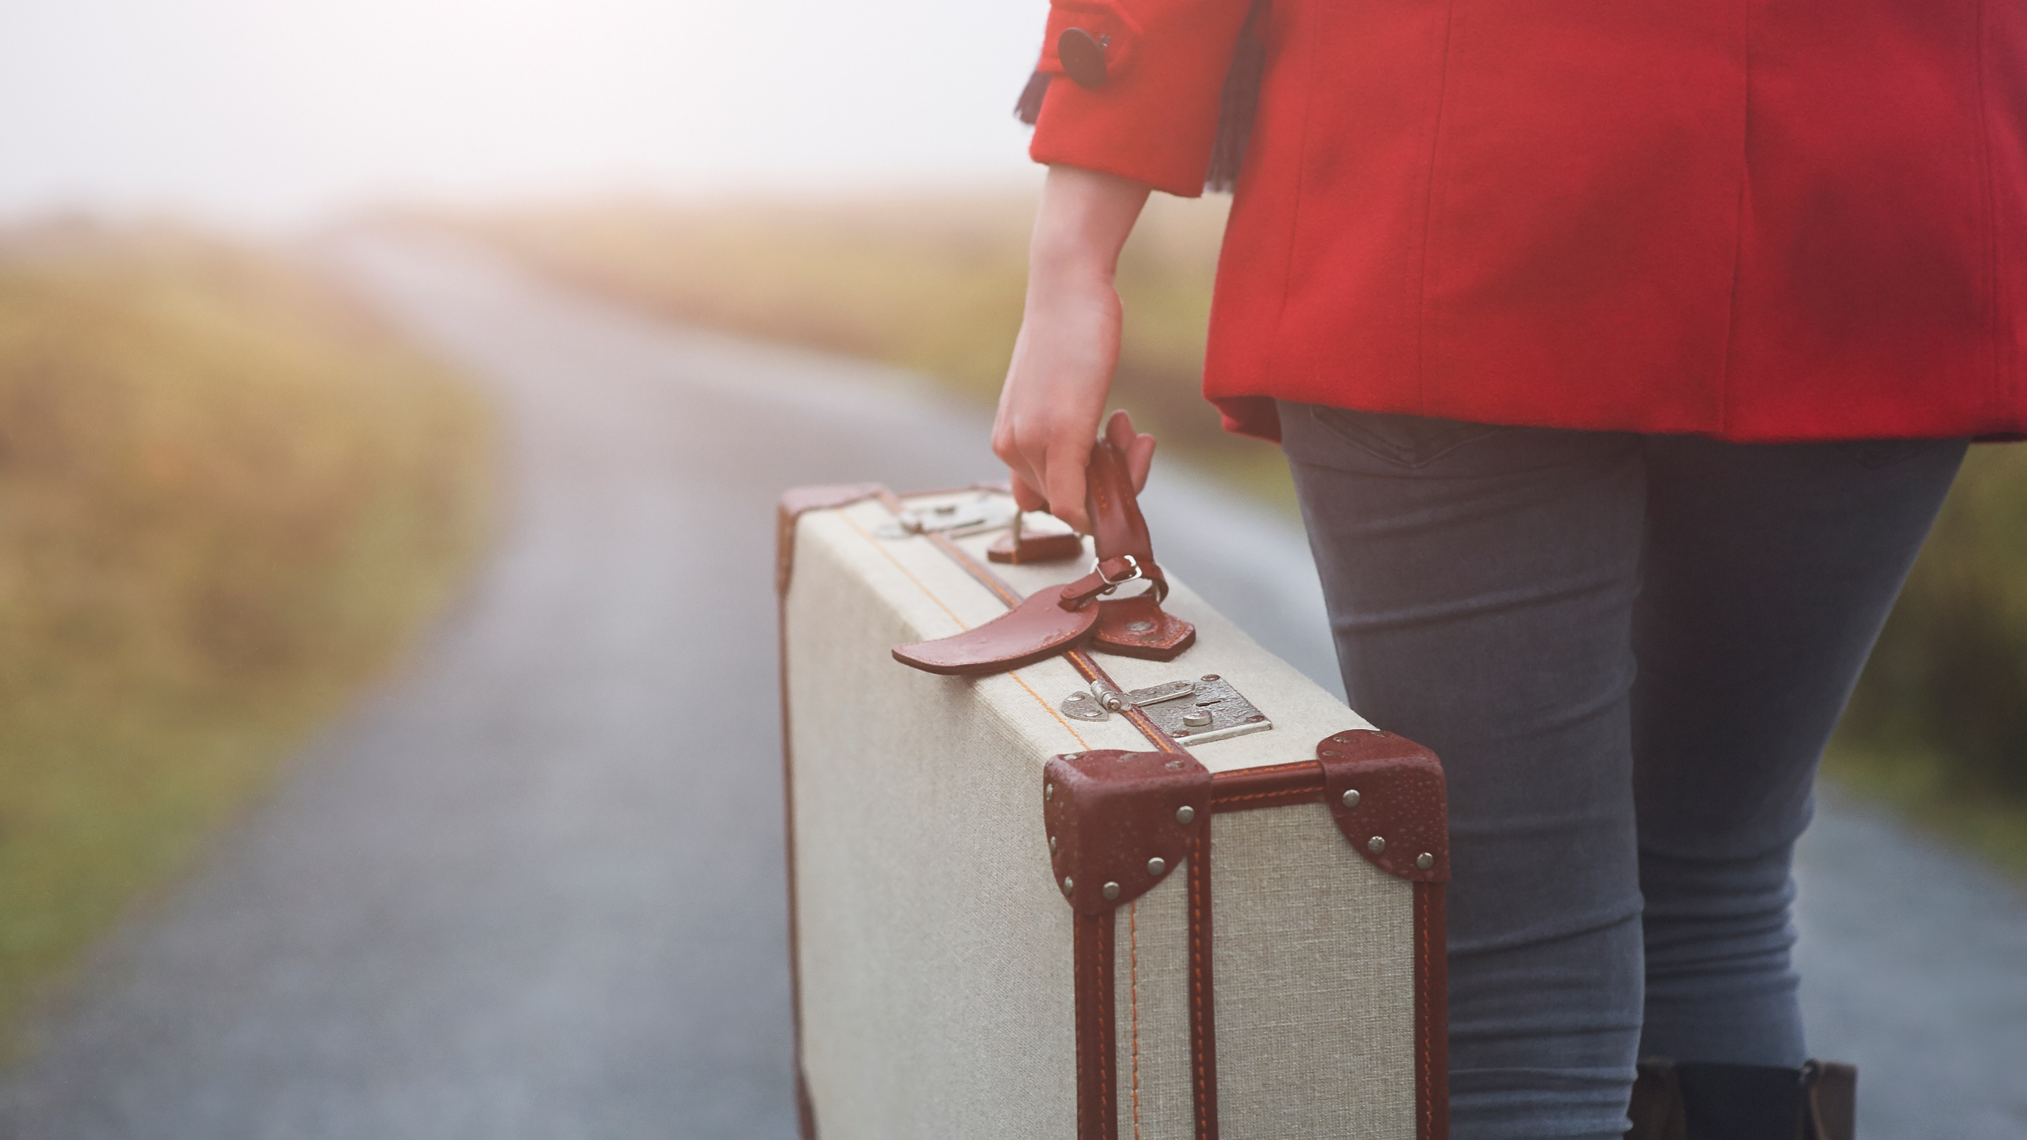
Thank you
someone@example.com

